Slide 1
`Hennebergisches Gymnasium Georg Ernst´
History
School Life
Holidays
KlosterNews
Clubs at HGS
Classtrips

Slide 2
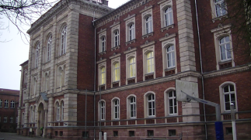
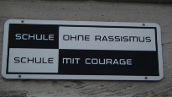
History
1502 – 1545 our school was a monastery
1559 decition to build school
${22}^{nd}$ June 1577 foundation of our school
${17}^{nd}$ October 1577 foundation `Alumnat´
at first boarding school for boys, later for girls ,too
1947 Max Greil Oberschule
1991 Hennebergisches Gymnasium Georg Ernst
1999 lessons in containers during constuction of a second building
2002 new building finished, ${425}^{th}$ anniversary of our school
Today: `Europa Schule´, MINT award

Slide 3
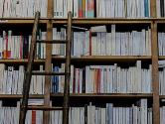
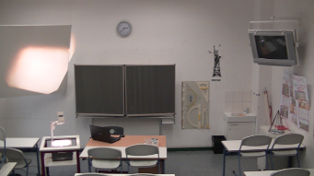
School Life
start: 7:35
one lesson= 45 minutes
lesson (1)
8:20-8:20 break after that lesson (2)
after every lesson breack
9:10-9:25 break (breakfast) after that lesson (3)
10:10-10:20 break after that lesson (4)
11:05-11:20 break after that lesson (5)
12:10-12:15 break after that lesson (6)
13:00-13:45 big break (lunsh)
lunsh on market or canteen
maybe 7&8 lesson (depends on timetable)
NO SCHOOLUNIFORMS
MFL classroom (Frensh)

Slide 4
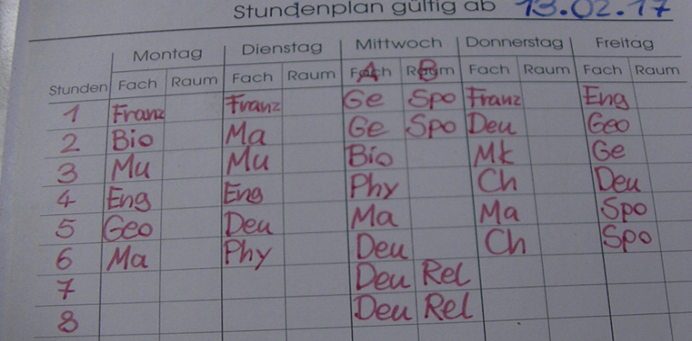
Timetable
created by Mr. Butz
A&B weeks

Slide 5
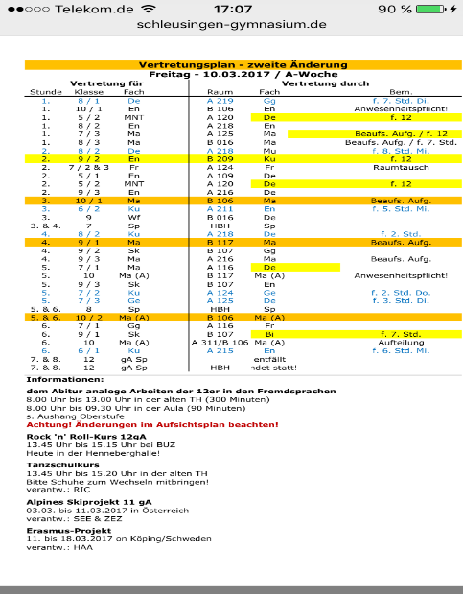
Substitute plan
created by Mr. Butz
Visible from second break
Able to find in the internet

Slide 6
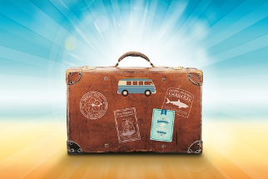
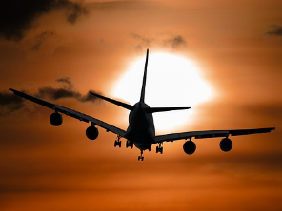
Holidays 1
- Winter Holidays: 06.02. - 11.02.
- Easter holidays: 10.04. - 21.04.
- Pentecost holidays: 26.05.
- Summer holidays: 26.06. - 09.08.
- Autumn holidays: 02.10. - 14.10.
- Christmas holidays: 22.12. - 05.01.
58 days of holidays in year 2017
This year the schooldays are less then then
last year

Slide 7
`Klosternews´
At our we have got a newspaper: the `Klosternews´. It´s a project for year 10, which is made every year. It is one bestseller of our school. Nearly every student byes the newspaper.

Slide 8
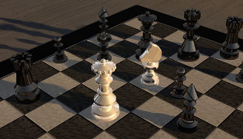
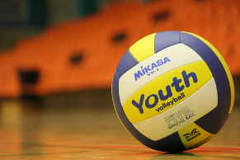
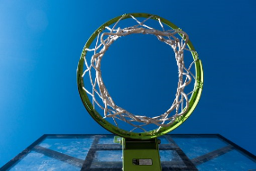
Clubs at HGS
chess club
Volleyball club
math class
basketball club
video club
Young Voices (choir)

Slide 9
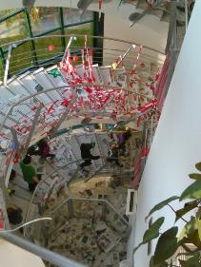
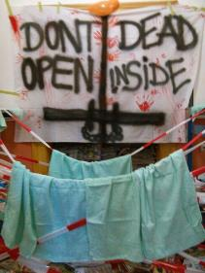
Classtrips/celebrations
casstrips
year 5: normal classtrip (one week)
year 7: alpine ski project (one week)
year 9: trip to `Buchenwald´ a former concentration camp
year 11: trip to: Frensh or Italy (Rome)
celebrations
October: `Stöbselball´ celebration for year 5
February: `Maskenball´ celebration of carnival
Abitaufe: to celebrate the passed examination of year 12
party at the market
costumes
baptism in `Abiwanne´
party (over night) in school building

Slide 10
THE END
Thank´s for listening

Slide 11
Sources
https://www.google.de/search?q=geschicht+gymnasium+schleusingen&biw=1600&bih=720&source=lnms&tbm=isch&sa=X&ved=0ahUKEwiauOGIur_SAhUDuxQKHXnxBDsQ_AUIBygC&dpr=1#imgrc=87tiQmHWNybGCM:
https://www.google.de/search?q=geschicht+gymnasium+schleusingen&biw=1600&bih=720&source=lnms&tbm=isch&sa=X&ved=0ahUKEwiauOGIur_SAhUDuxQKHXnxBDsQ_AUIBygC&dpr=1#imgrc=safLkwaRfDIBlM:
https://de.wikipedia.org/wiki/Hennebergisches_Gymnasium_%E2%80%9EGeorg_Ernst%E2%80%9C#Zeit_der_DDR
https://www.google.de/search?q=gymnasium+schleusingen&biw=1600&bih=720&source=lnms&tbm=isch&sa=X&sqi=2&ved=0ahUKEwiJ5fyeyr_SAhXCuxQKHRZcBDUQ_AUICCgD&dpr=1#imgrc=JOYoONfijwZVOM:
https://www.google.de/search?q=klosternews&biw=1600&bih=720&source=lnms&tbm=isch&sa=X&ved=0ahUKEwiRqJ3N98bSAhUhYZoKHQNpCDYQ_AUIBygC#imgrc=rLAnQWm1oZtC3M:
https://pixabay.com/de/photos/?q=schachspiel&image_type=&cat=&min_width=&min_height=

