Slide 1
PERSHORE HIGH
Josh Noon and Daisy Wild

Slide 2
Term Dates
Terms vary between 12-14 weeks.
We have a mid term break (half term) for a week.
At the end of Autumn term we have Christmas holidays (2 weeks), Spring Term we have Easter holidays (also 2 weeks) and at the end of the year, a 6-7 week summer break.

Slide 3
Times of Day
Most people get buses to school and get there 8:20+.
School starts at 8:50 am,
Tutor for 10 minuets.
Lessons 1 and 2 are between 9 and 11
Twenty minuet break.
Lesson 3 and for are from 11:20 to 1:20.
Lunch is 45 minuets long and ends at 2:10.
We then go back to tutor for 20 minuets
Lesson 5 from 2:30-3:30
School ends at 3:30.

Slide 4
Timetable
The subjects we study at school are as followed:
English
Maths
Science (Biology, Chemistry and Physics)
French and German
Music
Art
Drama and Performing Arts
History Geography and Religious Studies
Philosophy and Ethics
Food and Nutrition
Visual Communication/Graphic Design
Textiles
Electronics
Resistant materials
ICT
Computer Science
P.E

Slide 5
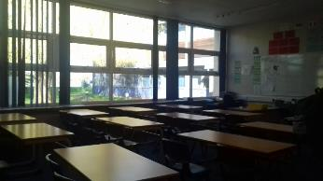
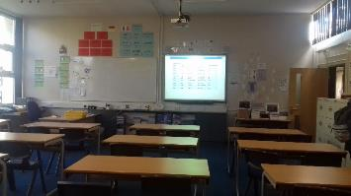
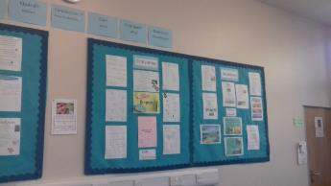
MFL Classrooms
This is one of our MFL classrooms (L2). We have lots of resources, such as interactive whiteboards, normal whiteboards and help vocabulary cards around the room. We have 4 language classrooms in the school (2 for German and 2 for French).

Slide 6
The Canteen
The canteen is where most people eat at school. You can buy hot and cold meals. They also have a wide variety of crisps.
The menu often changes except on Friday, when we have Fish and Chips.
Instead of paying with money, we use our fingerprints sort of like a mini bank account for food. This prevents theft because you cant steal someone's finger.

Slide 7
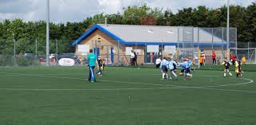
Sports Facilities
In our school we have a lot of good facilities for sport. We have:
An all weather astro turf, football and hockey pitch. (floodlit)
Tennis and netball courts.
Rugby and football pitches on the field.
A gym with trampolines and one basketball court.
A sports hall with badminton and basketball courts.
A girls and a boys changing room.

Slide 8
Other Facilities of Interest
In our school we also have lots of facilities that are nice to have.
A drama studio with special lighting systems
Lots of computer rooms all around the school
Music room with 35 apple macs in
Music room with 30 keyboards and guitars
An assembly hall
A dining hall

Slide 9
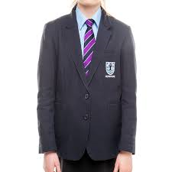
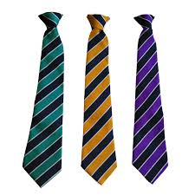
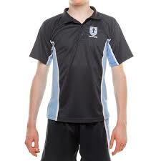
Uniform and P.E kit
A tie, the colour depends on the house (green, gold or purple)
A light blue shirt
A Dark blue blazer
Black trousers
Black shoes
Black socks
A Pershore polo shirt ● Navy blue socks
Shorts ● A skort for the girls (skirt with shorts)

Slide 10
Trips and Activity's
A lot of the trips are linked to lessons rather than year groups. There has been an art trip to a museum, a history trip to the imperial war museum and there will be a trip for the year 8’s.
There are a lot of sports clubs as well as debating club and chess club.
Each year has lots of teams in different sports. Such as football and netball.
Every year there is a schools cross country and if you do well you go to the county, which is the area, and then the nationals.

Slide 11
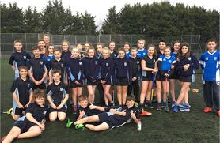
Sports Academy
This year a sports academy has been set up to improve the best sports people in the schools coaching skills within sport and their skills.

Slide 12
Organisation
Homework in main lessons such as French and science, is set every two lessons.
There is a homework planner to help students with homework and if it isn’t handed in you get a detention at lunch.
Epraise is a reward system where you get points for effort and good work. With those points you can buy different things like food and vouchers.

