Slide 1
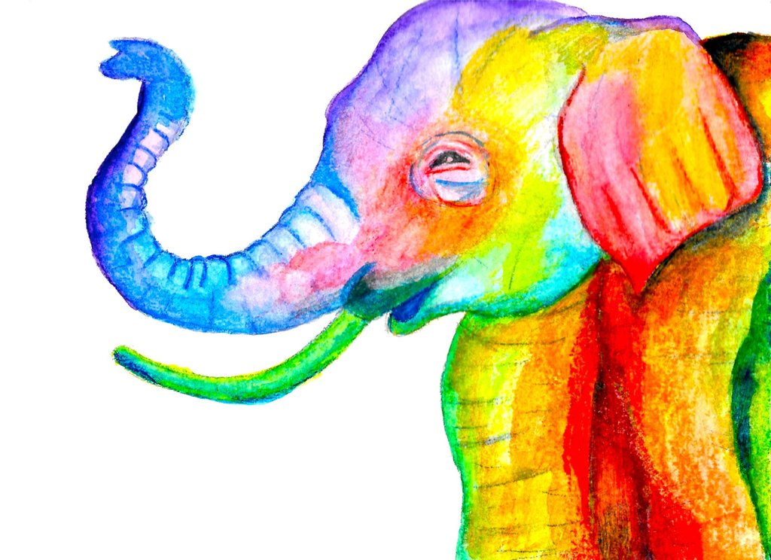
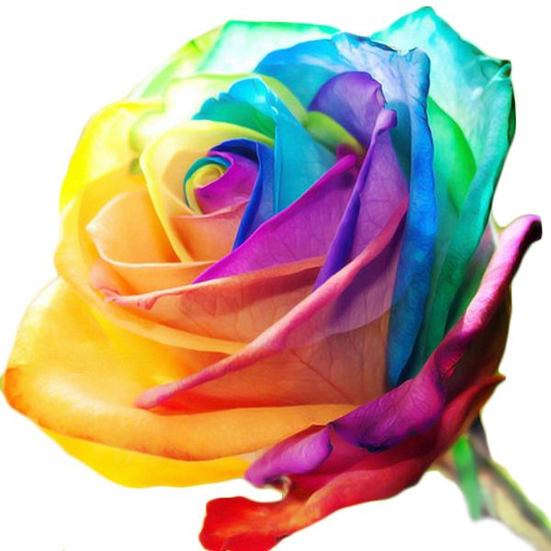
Colour
By Luke, grace, lily & Katie

Slide 2
Guess The Colour
(In French)
We will show you a colour and you have to write down what colour it is in French on your mini whiteboard!

Slide 4
Rouge

Slide 6
jaune

Slide 8
Rose

Slide 10
Vert

Slide 12
Violet

Slide 14
Orange

Slide 16
Bleu

Slide 17
Word search
Find the words in French
Blue
Purple
White (female)
Black (female)
Green ( plural)
Yellow (plural)
Red

Slide 18
Word search-Answers
Find the words in French
Blue
Purple
White (female)
Black (female)
Green ( plural)
Yellow (plural)
Red

Slide 19
Cross Word
https://ellowes-my.sharepoint.com/:x:/r/personal/caddickl_ounsdale_staffs_sch_uk/_layouts/15/Doc.aspx?sourcedoc=%7B146c3ee8-f396-4057-8e23-4715e7824c9a%7D&action=default

