Slide 1
Starter Task Quiz/Crossword
By: Amelie, Lottie, Summer, Lily, Charlotte

Slide 2
Now get into your teams:
Team 1: team 2: team 3: team 4: team 5:
Kenzie Dizzy Nat Billy Ben S
Elle-mae Fizzy Ben H Kieran S David
Denaya Beth Ollie Charlie Kieran L
Elloise Grace Tom Awais
Carter

Slide 3
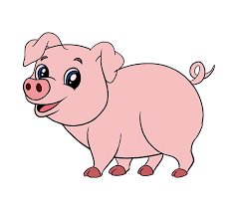
Q1: State whatever it is in the picture in French

Slide 4
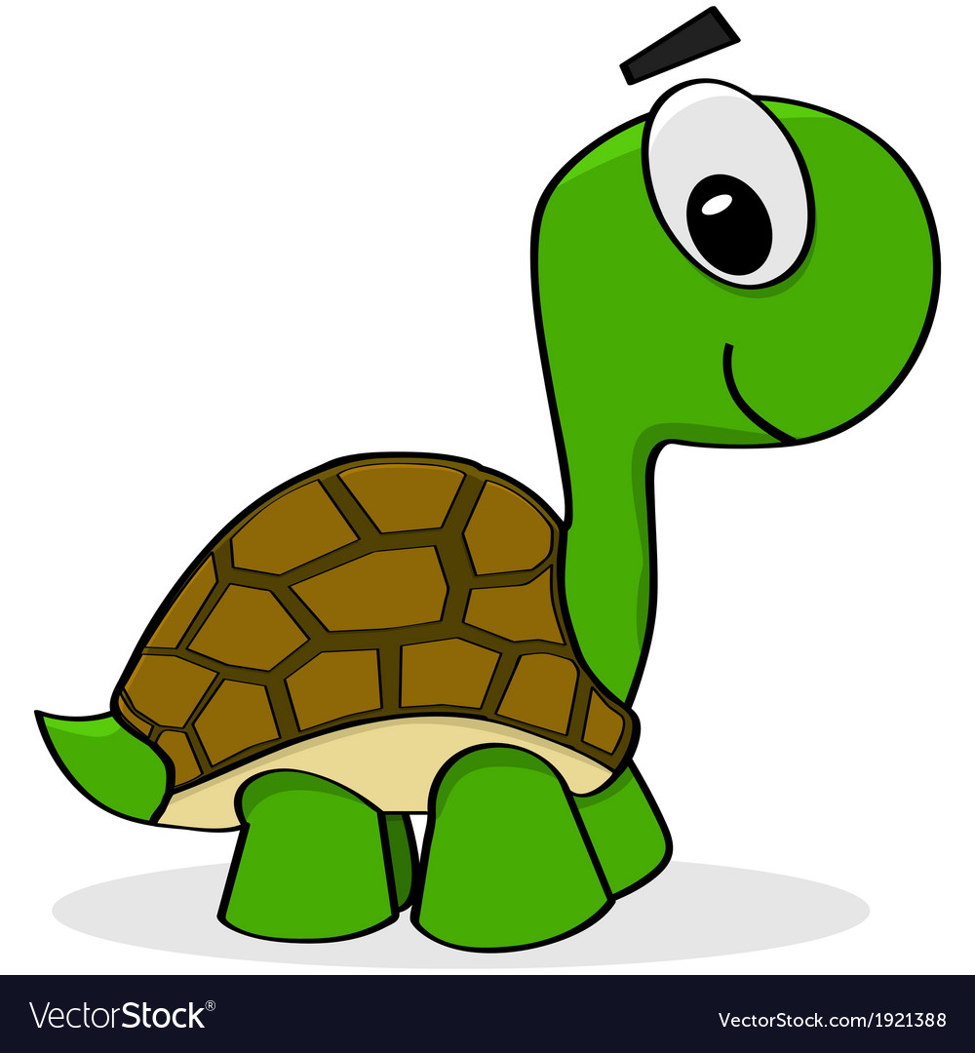
Q2: State whatever it is in the picture in French

Slide 5
Q3: State the word in English:
souris

Slide 6
Q4: State the word in English:
lapin

Slide 7
Q6: State the picture in French and in English

Slide 8
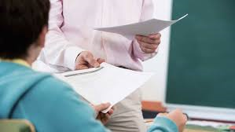
Pass your answer sheets to the front

Slide 9
And the winner is ….

Slide 10
Team

Slide 11
THANK YOU BYE!
☺

