Slide 1
Who wants to be a millionaire?
(French version!)
By Leah, Harriet, Mia and Evie.

Slide 2
Starter Activity!
Everyone needs to get a plain sheet of white paper so they can write their answers down. The answers will be at the end of the power point ☺

Slide 3
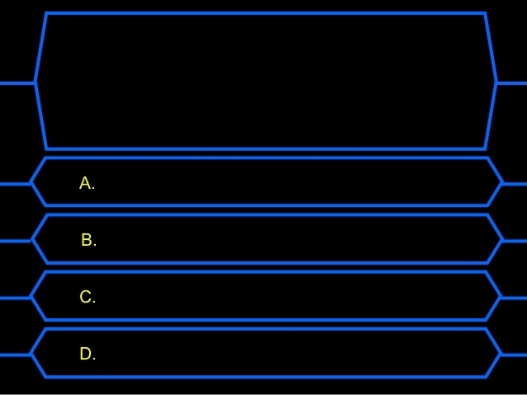
Question 1-
What is the French word for an Eraser?
Le calculatrice
Le stylo
Une gomme
Un sac

Slide 4
Question 2-
What do they measure with, in France?
Une regle
Un livre
Un cahier
Un portable

Slide 5
Question 3-
What do French kids earn every week?
Un portable
Un porte-monnaie
Un stylo
Une trousse

Slide 6
Question 4-
What do they write with, in France?
La colle
Un sac
Le stylo
Un portable

Slide 7
Answers….
Tick or cross your answers then calculate your final score!

Slide 8
Question 1-
The correct answer is C.
Question 2-
The correct answer is A.
Question 3-
The correct answer is B.
Question 4-
The correct answer is C.
Thank you for listening ☺

