Slide 1
OPINIONS
Erasmus+
By William T, Edward P, Jack B and Ruben D

Slide 2
The first game will be to try and guess what the picture means by writing it on your white board.

Slide 3
ARE YOU READY?

Slide 4
The answer is…
Je Deteste

Slide 5
The answer is…
J’aime

Slide 6
The answer is…
J’adore

Slide 7
The answer is…
Je n’aime pas

Slide 8
THAT’S THE FIRST PART OVER!
FOR THE NEXT PART WHAT YOU NEED TO DO IS WRITE A,B,C OR D AND FOR THE LAST FEW Y = Yes OR N = No!

Slide 9
ARE YOU READY?

Slide 10
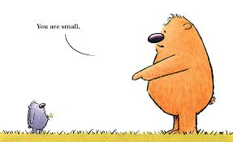
A = tu est petit(e)
B = tu a gentil(e)
C = tu es petit(e)
D = tu beau
The answer is…
C = tu es petit(e)

Slide 11
A = cool
B = grand(e)
C = poli(e)
D = impatient(e)
The answer is…
B = grand(e)

Slide 12
A = charmant(e)
B = drole
C = belle
D = cool
The answer is…
A = charmant(e)

Slide 13
Grand(e)?
The answer is…
Yes Or No
No

Slide 14
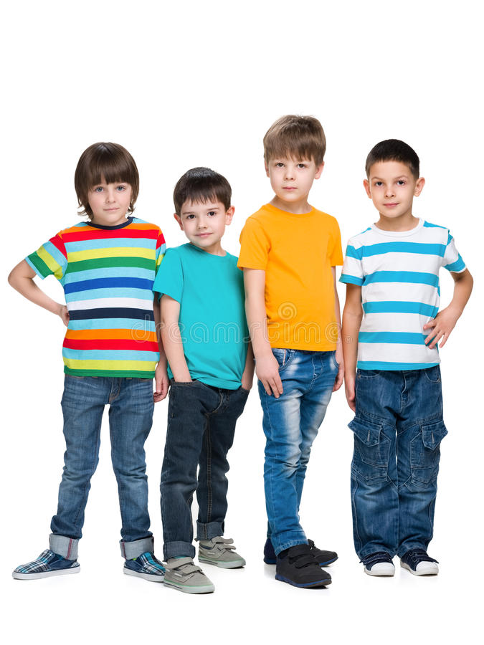
De taille moyenne?
The answer is…
Yes Or No
Yes

Slide 15
Modeste?
The answer is…
Yes Or No
Yes

Slide 16
THAT’S THE SECOND PART OVER
FOR THE LAST PART YOU NEED TO PUT YOU HAND UP AND GUESS THE MISSING WORDS IN THE CROSSWORD OF MORE THINGS WE HAVEN’T DONE AND SOME OF THE THINGS WE HAVE DONE!

Slide 17
IT’S TIME TO FACE THE CROSSWORD CHALLANGE!
1
B
L
2
I
3
L
O
N
G
S
N
N
4
D
T
D
R
5
G
E
N
E
R
E
U
S
E
O
6
DOWN:
1. BLOND
2. INTELLIGENT
4. FUNNY
6. CURLY
7. IMPATIENT
9. CURIOUS
11. GENTLE
L
F
L
7
I
L
8
B
R
A
N
9
C
H
E
E
M
10
R
A
I
D
E
S
I
U
P
G
11
G
S
R
12
D
E
T
A
I
L
L
E
M
O
Y
E
N
N
E
I
13
T
N
N
S
P
E
T
I
T
E
ACROSS:
3. LONG
5. GENEROUS
8. TRENDY
10. STRAIGHT
12. MEDIUM-HEIGHT
13. SMALL
14. GOOD-LOOKING
I
T
T
U
14
B
E
A
U
E
I
X
N
L
T
E

Slide 18
French Games

Slide 19
Thank You Very Much For Watching

