Slide 1
Our school – Ounsdale high school
By Phoebe Wilkinson and Edan Powell

Slide 2
OUNSDALE

Slide 3
Who are we?
This may be the first time some of you have met us. Our names are Phoebe and Edan. We are both 14 and are both students at Ounsdale High School in England.
Edan is a very loud, fun person who quite often loves to do most of the speaking. Edan also speaks English and is learning Spanish but would love to learn many more languages.
Phoebe is funny, sporty, loud and confident. She loves to sing and loves huskies. She goes to the gym regularly and would like to go to Australia.

Slide 4
Times of the day
This is the time schedule of an Ounsdale student
Warning bell – 8:40am
The warning bell is a bell that is sounded to tell you to start heading to your tutor. You are still not required to be in school at this time.
Tutor – 8:45am
You have to be in school and in your tutor by 8:45am and if you arrive at the gate from 8:45am or later, you will be given a late and you will have a 10 minute detention after school.

Slide 5
Times of the day
Tutor lasts for 20 minutes, meaning it ends at 9:05am. In tutor, we do equipment checks, quizzes, maths booklets and other things. Edan’s tutor room is conveniently a computer science classroom meaning he is allowed to use the computers. He often uses Duolingo to practice Spanish

Slide 6
Times of the day
After tutor, the day goes like this
Period 1 9:05
Period 2 10:05
break 11:05
Period 3 11:20
Lunch 12.20
Period 4 13.00
Period 5 14.00
Ends 15.00

Slide 7
Term Dates
Ounsdale has 3 full terms, split into half terms. The full terms are Autumn, Spring and Summer.
Autumn September - December (2 week holiday at Christmas)
Spring January – Easter (2 week holiday at Easter)
Summer Easter - middle of July (6 week summer holiday)
We also get 1 week of holiday in the middle of each term

Slide 8
Our timetables
Timetables at Ounsdale are split in to two weeks: week one and week two. Each week, we have a different timetable.
Here is a picture of Phoebe’s timetable:

Slide 9
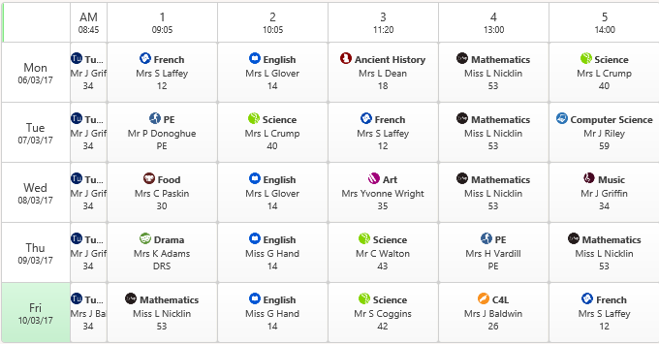
WEEK 1

Slide 10
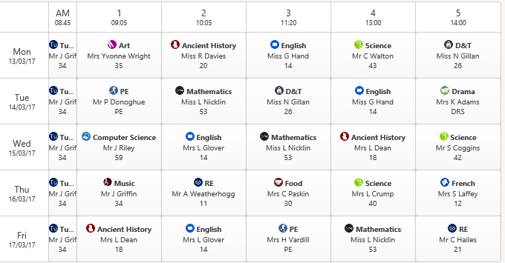
Our timetables

Slide 11
Our timetables
Every week we get
4 lessons of English
4 lessons of Maths
3.5 lessons of Science
2 lessons of French or Spanish
2 lessons of PE
Plus 1-2 lessons of all the other subjects

Slide 12
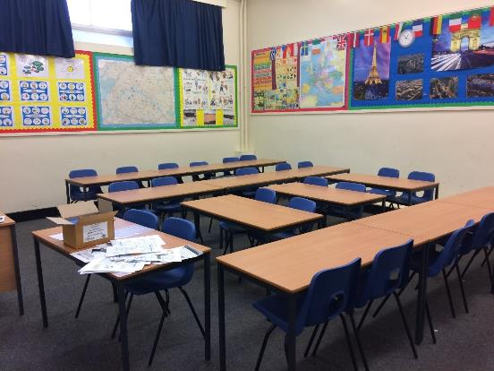
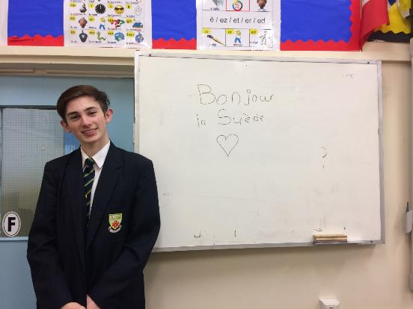
Mfl classrooms
At Ounsdale, we have 3 foreign language classrooms: Room 9, Room 10 and Room 12. Here are pictures of Room 12

Slide 13
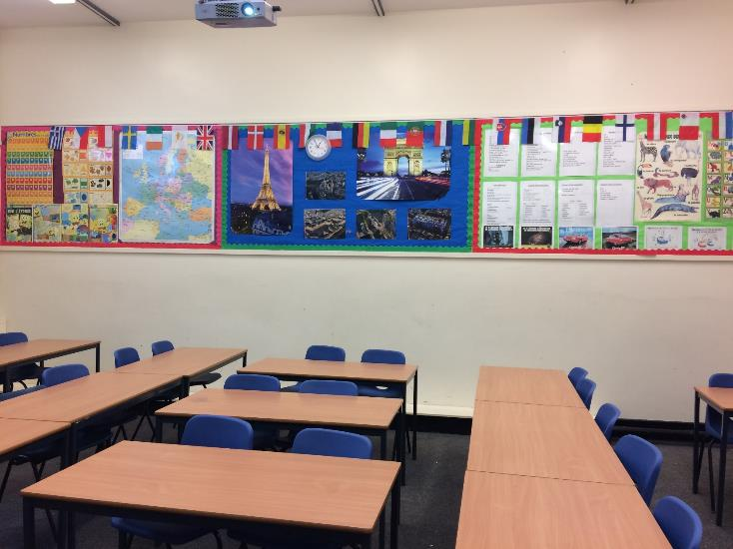

Slide 14
Sports facilities
At our school, we have a large range of sports facilities available. We have
tennis courts
an enormous field,
a gymnasium
a sports hall with lots of equipment.
We have the equipment for
badminton, table tennis, football, basketball, handball, lineball, trampolining
Here are pictures of some of our sports facilities

Slide 15
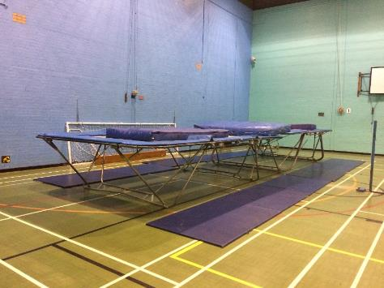
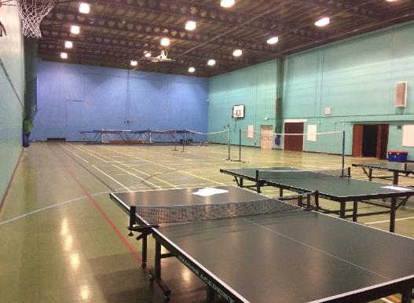
Sports facilities

Slide 16
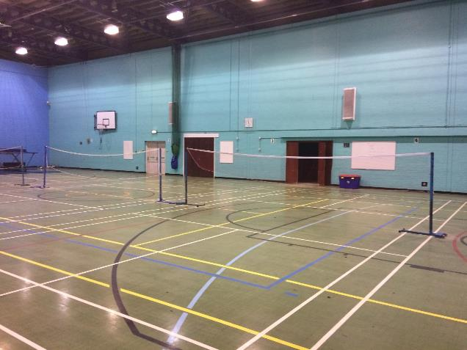

Slide 18
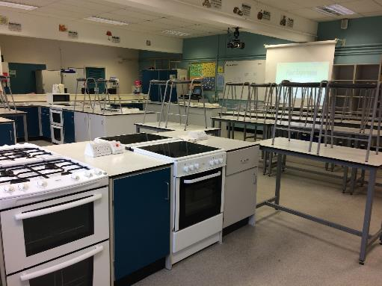
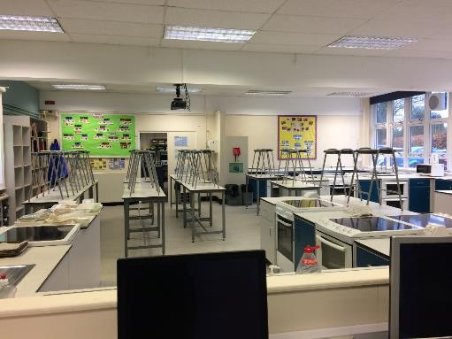
Other facilities of interest
Food technology classrooms. These are used for both theory and practical food technology.

Slide 19
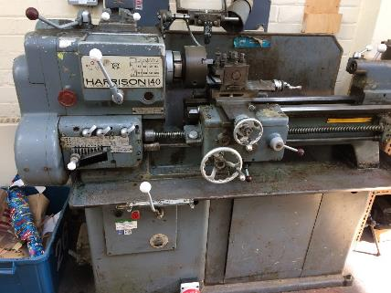
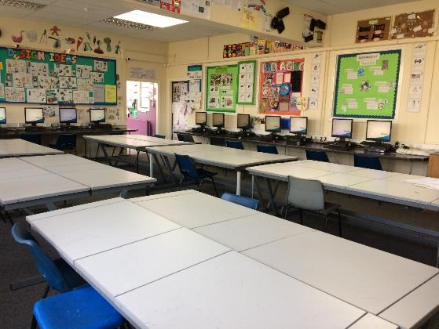
DT CLASSROOMS/WORKSHOPS

Slide 20
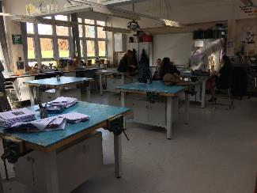
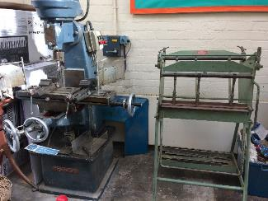
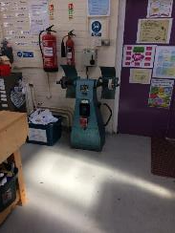
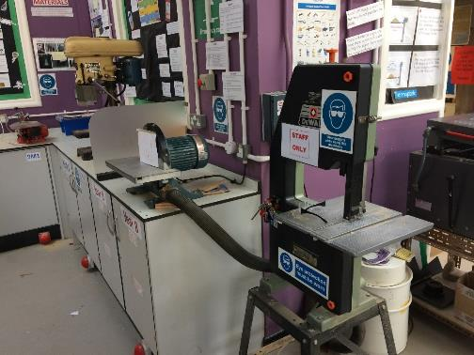
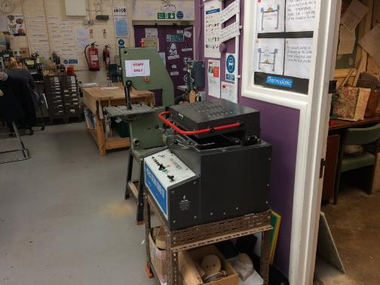

Slide 21
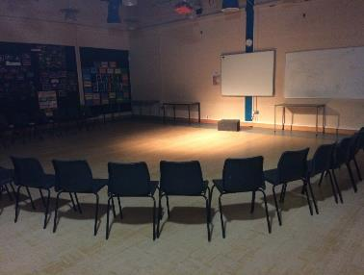
Drama Studio
Both the drama studio and the hall are fully equipped with lighting, sound and technical equipment

Slide 23
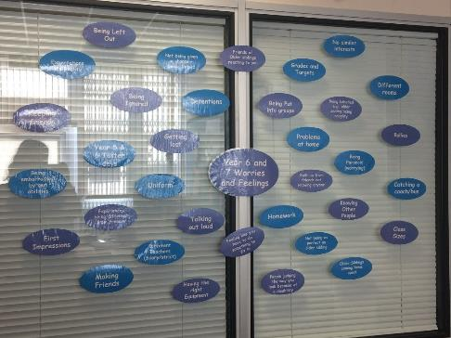
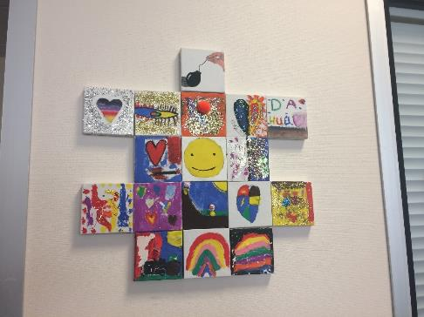
The hub
The hub is used for many things, including helping people who struggle in class, people with learning difficulties, mentoring, pastoral support, etc. It is a welcoming and comfortable environment.

Slide 25
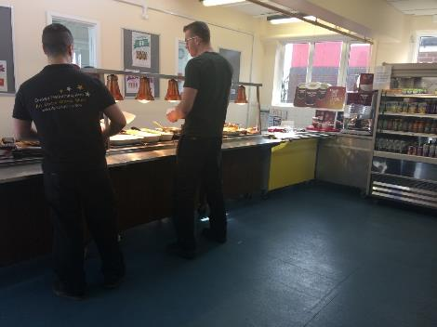
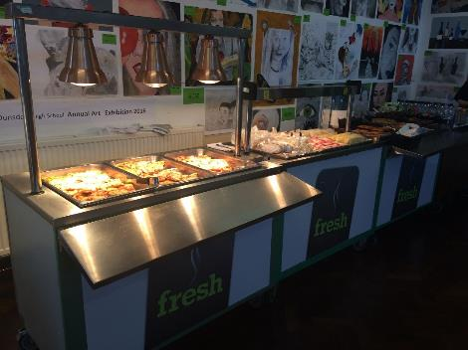
Canteen
Food can be purchased before school, at break and at lunch.

Slide 26
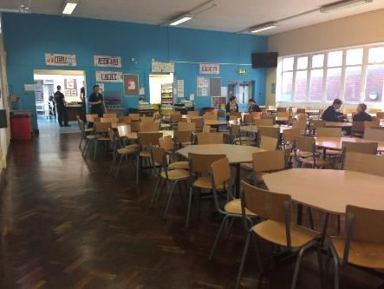
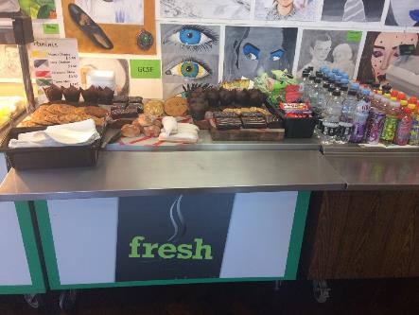
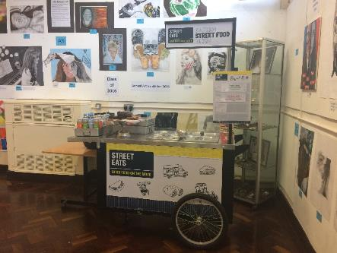

Slide 27
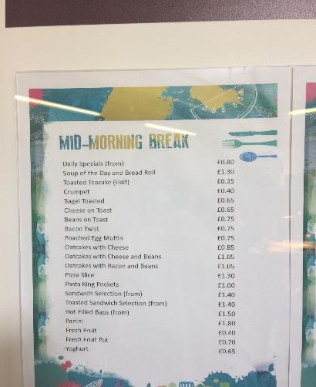
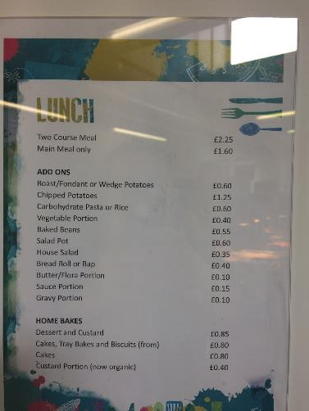
Menus

Slide 29
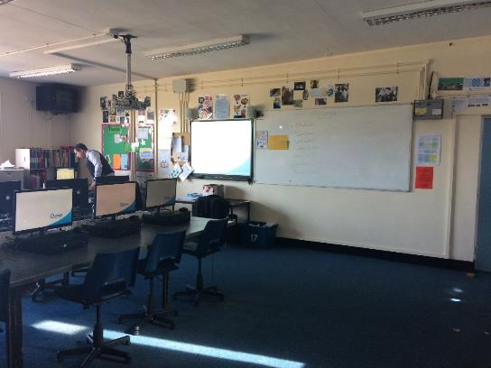
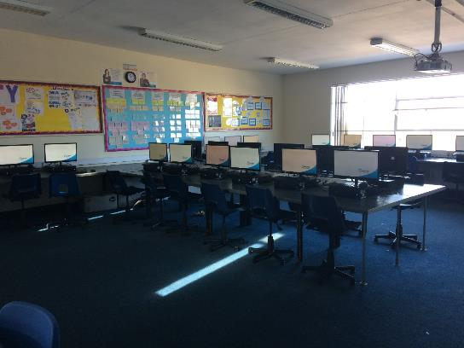
IT facilities
Ounsdale has many computer rooms, including a music computer room where you can compose and record!

Slide 30
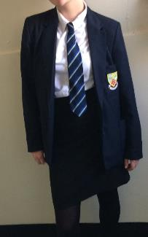
Uniform
Boys and girls generally tend to wear different uniform however, girls can wear almost exactly what boys wear. We also have 4 different houses whose members all have different ties. Phoebe is in the blue house: Scott. Edan is in the green house: Fiennes.
Phoebe wears a blazer, white shirt
a Scott tie and a logo skirt. Girls are allowed to
wear trousers too.

Slide 31
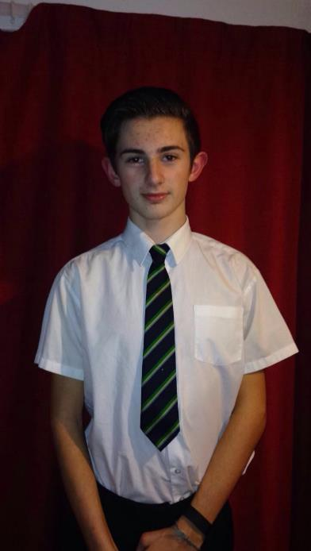
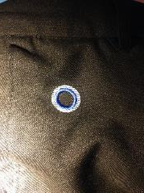
As you can see, Edan is not wearing his blazer in these pictures, although this is essential in school (with the exception of when it gets hot in summer). The logo on the trousers can be seen in this picture. Edan has a Fiennes tie as he is in the Fiennes house.

Slide 32
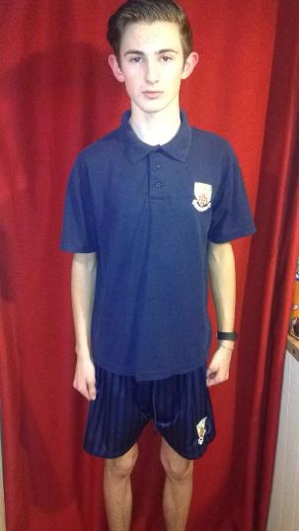
PE uniform
Every student has to wear our PE top, our light and dark blue football socks and girls have to wear a skort (sports skirt). Students have the choice of which shoes they wear, as long as they are not fully black and are trainers.
Boys however, have to wear our PE shorts. During winter months, students can wear a PE sweatshirt and PE track suit bottoms, but these are not essential and neither of us own them.

Slide 33
Reward trips and educational visits
Typically at the end of the year, each year group goes on a trip. We have been to the safari park, a theme park and an ice rink as a reward trip however, this year, we will go somewhere different.
We also go on educational trips. For example:
Y7 PGL, a residential visit for outdoor activities.
Y8/9 Skiing in Italy
Y8 Trip to France
Y9 History trip to the battlefields in France and Belgium

Slide 34
Thank you
We would like to thank all of you for paying attention. Please do not hesitate to ask any questions even you think they are “silly”☺.
Thank you for listening. We hope you enjoyed it ☺

