Slide 1
My school

Slide 2
Times of day and term dates
Normal school day is 6 hours
Lessons are 45 minutes
Our lunch break is at 10:15, 11:15 or 12:15 and it is 30 minutes
Fall semester starts in August (last year August 14th) and ends in December (last year 20th December)
Spring semester started this year January 4th and it ends June 3rd
We have 5 different timetables each year

Slide 3
Timetable

Slide 4
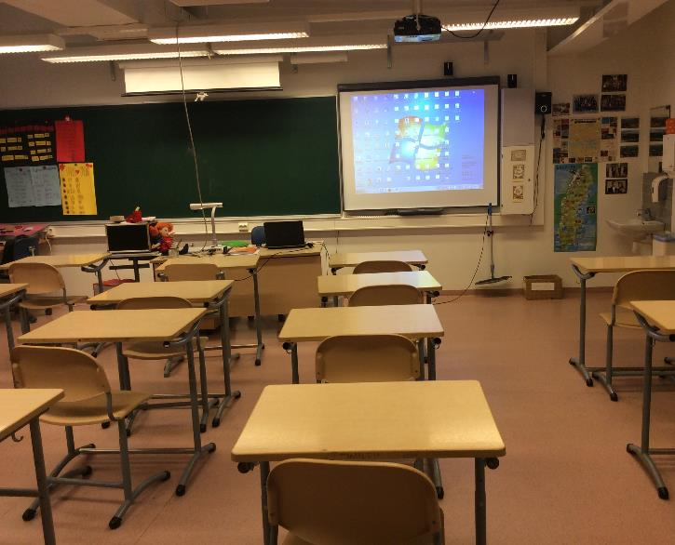
MFL classroom

Slide 5
Menu
Free school lunch every day
Meals are healthy and balanced
Option for vegeterians

Slide 6
What we wear for school
We can wear anything that is appropriate
For PE we wear T-shirts, shorts, jogging pants etc.
Gym shoes and sneakers
Equipment we get from school

Slide 7
Extra activities
In our last year we have one trip
We have to gather the money ourselves
Special days:
Pre Christmas-party
Carnevals
Independence day
Sports day
Many theme weeks

Slide 8
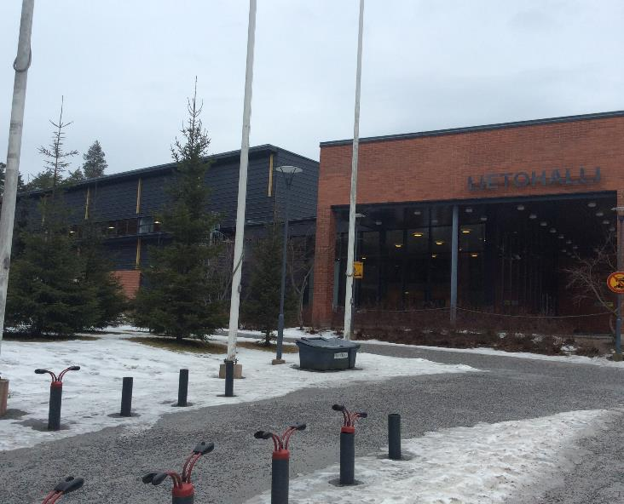

Slide 9
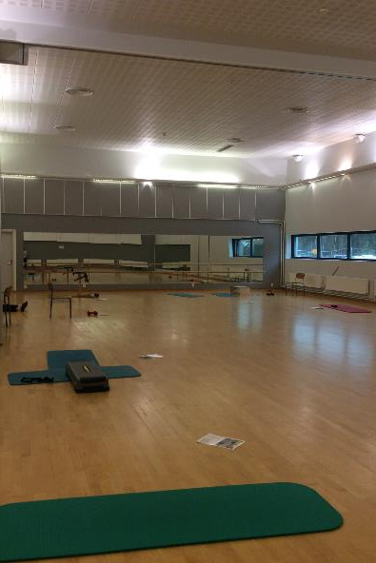
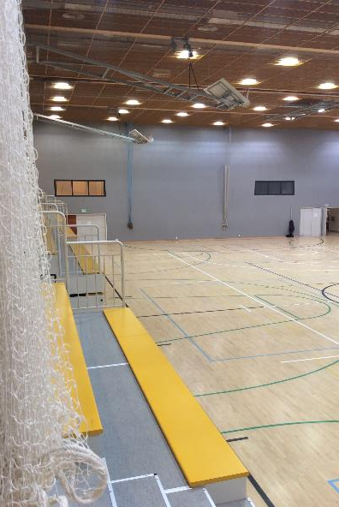

Slide 10
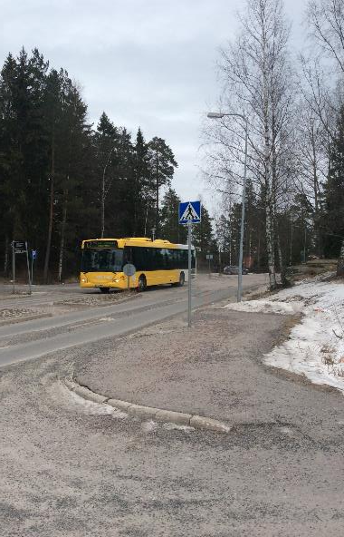
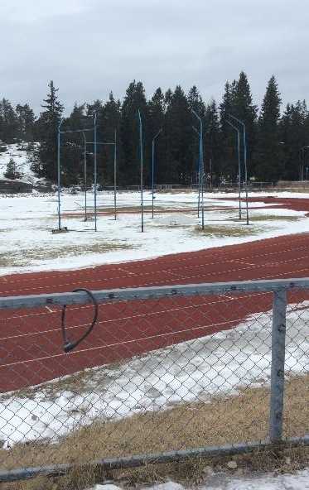

Slide 11
