Slide 1
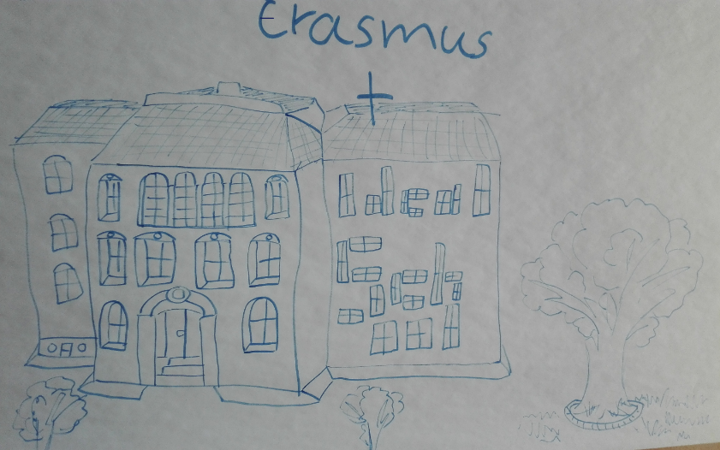

Ideal European school
TECHNOLOGY, EQUIPMENT,
SCHOOLDAYS, PE, TRIPS AND
UNIFORMS

Slide 2
THE CANTEEN
Our ideal canteen is wide, clean and comfortable
Menu has variety foods for everyone for example vegetarian food
The desks are in a circle so you can talk to each other and between the tables there is space to walk
On the tables there is decoration like flowers
You can get food everywhere from the canteen

Slide 3
THE FOOD
During the breaks and the lunch break you can get different snacks like pizza and biscuits.
In the lunch break you can eat many different foods, you can eat the main meal
For vegetarians there are fries and many vegetables.
You can get meal in every break.
The meal of the day is always fresh

Slide 4
THE PROGRAM OF THE SUBJECTS
The students are able to choose some of the subjects.
The students can get extra lessons for languages and other subjects if they want that for example if you want to study Japanese there can be possibilities for that
In the subjects there are a lot of creative activities
Small group sizes

Slide 5
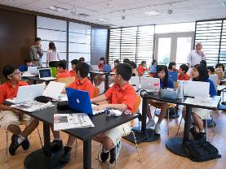

Les Technologies
Choose between iPads and MacBooks
When you’re sick you get homework to your own iPad with Showbie
Working is faster
Text is cleaner
No need for notebooks for every subject
Students can look up things on the internet and teacher can help other students
Music helps to concentrate
You can’t lose important notes

Slide 6
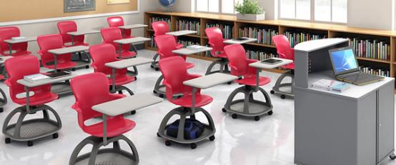
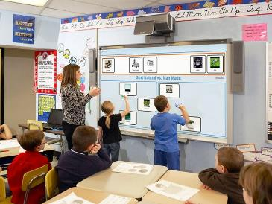
Equipment
New books with new information
Good calculators
Smart desks and chairs
Smartboards and beamers
Pencils and other equipments should be free
Power outlets in every desk
Good equipment in science for every desk

Slide 7
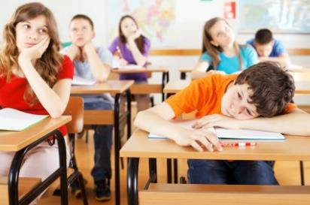
Schooldays
From 8am to 2pm
6 lessons à 45 min
Short breaks, about 5mins
Long lunch break (45mins)

Slide 8
PE
at least two hours a week
students can decide if they want more lessons
when it is summer, PE should include ball games (e.g. basketball, handball, football, volleyball, waterball) and outdoor activities
in winter PE should include outdoor activities with snow and ice and also indoor sports

Slide 9
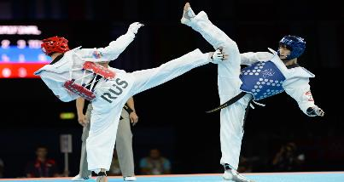
should be balanced and include lots of rare and interesting kinds of sports
for example: self-defence, climbing, mountain biking, frisbee golf

Slide 10
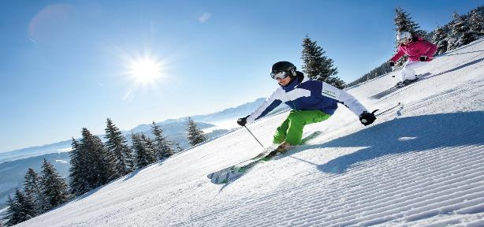
Other sport activities
swimming, dancing, gymnastics, cheerleading, acrobatics, zumba, athletics, competitions, archery, hiking, geo- catching, orienteering, going to the gym, self defence

Slide 11
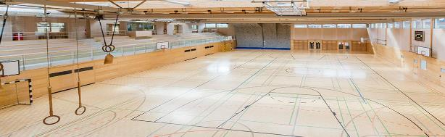
PE equipment
new equipment
trampolines, football field, swimming pool, gym hall, gym, goals, sticks, ice rink, all kinds of balls, climbing wall, dancing hall, dressing room, nets
modern and user friendly equipment

Slide 12
Trips
Trips should be fun and educating
Students should get the chance to choose where to go
More fun trips in the spring
Learning trips in autumn and in winter
Students should gather money themselves
Parents and other peolpe could donate
Trips should be free

Slide 13
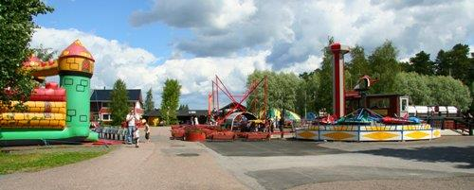
Ages 7- 9 | Ages 10- 12 | Ages 13- 15 | Ages 16- 18
Boat trips | Swimming camps | Sleep over night trips | Trips to other countries
camping | Small fun parks | Fun parks | One week trips
skiing | zoo | Skiing | Student exchanges
Trip to nearby town | Trip to nearby city | To the capital | To big cities abroad
museum | Museum
 | skiing

Slide 14
Cultural exchange
An Ideal European School:
Should give the students the opportunity to get to know each other via
Skype, e-mail, social media, post cards
Should offer language trips
Students should attend language classes
Should have partner schools

Slide 15
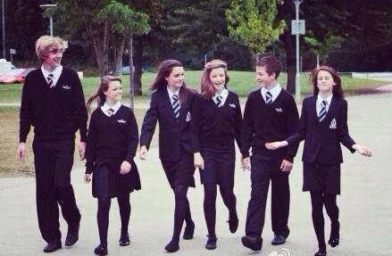
School uniforms
No uniforms
Unless there are some advantages:
Students don`t have to choose clothes in the morning
Nobody is being bullied
because of cheap, ugly
or old clothes
But students should be
free to choose, what to wear
Same clothes for competitions only

Slide 16
Relationships between the teachers and the students
Teachers can not think that they are better than students, but must be equal. This means that students should call the teachers by their name, not their surname. Teachers should spend more time together with students at break and this lets students and teachers talk more (meaning students feel safe going to teachers about problems).

Slide 17
Practical subjects
Subjects such as drama, music, science and home economics need special equipment: drama studios, music recording studios, science and cooking rooms. We would also need:
Sewing and joinery and metal works
Science rooms with materials

Slide 18
Lesson format
The lesson should be fun but they should also have discussions. In the classes, one must not sit alone but in groups of around 6 people, one must not sit alone. The teacher must not shout nor raise their voice without reason.

Slide 19
Education
We would like a huge building because it would make it easier to move around the building
We also believe that all schools should have large rooms, rest rooms, large libraries, a dark room with a bed to rest, music halls, lounges for school clubs, larger physical education facilities (includes a Sound for motivation, more private locker rooms (as each person has their own shower and have their own small changing room).
In addition it should have more technology (for example some rooms of computers)

